Slide 1
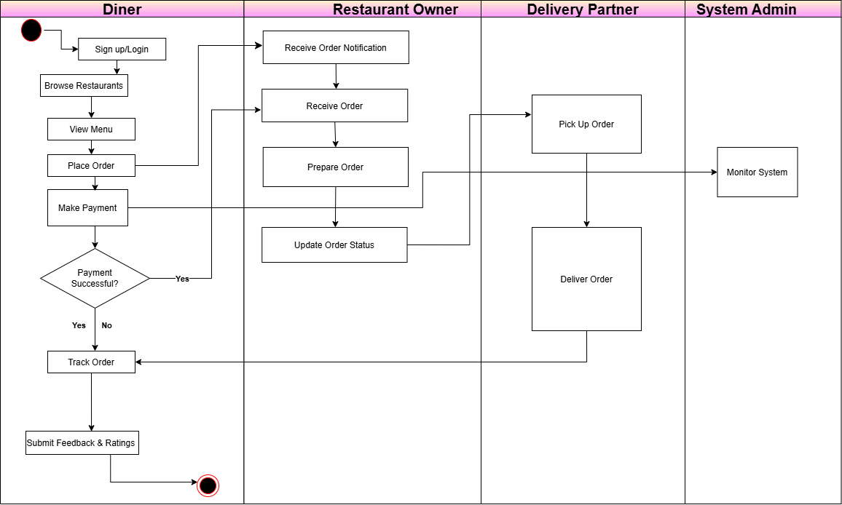
UML Activity Diagram: BiteBuddy

